Slide 1
Microsoft 365 & Power Platform Development – Bi-weekly call
Your host in this call: David Warner (Microsoft)
September 1st, 2022

Slide 2



v
Agenda
Latest Updates on community
PnP .NET libraries
PnP PowerShell
Independent Publisher Connectors
Latest on script samples
Latest Microsoft Teams samples
Latest on Power Platform samples
Picture time with the Together Mode!
Robin Rosengrün - Independent Publisher Connector - OpenAI connector on using AI for content creation and interactions
Kristine Kolodziejski - How to animate SVGs in Adaptive Cards

Slide 3
Opportunities to Participate in the community
Demo solution or technical pattern
Contribute on GitHub
Provide feedback
Great opportunity to get visibility for you or your company. Demo sample or explain how you extend or customize SharePoint Online with live demo in your projects. Reach out to team for volunteering.
Request a demo spot on the call
https://aka.ms/m365pnp/request/demo

Slide 4
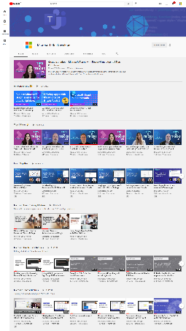
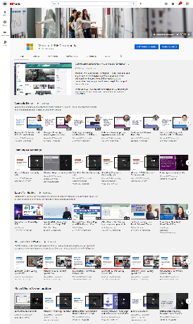
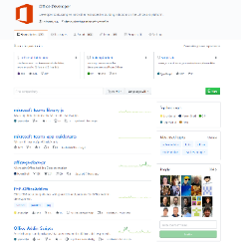
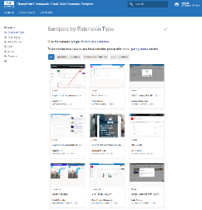
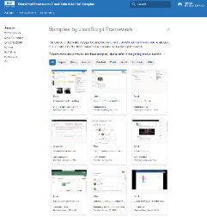
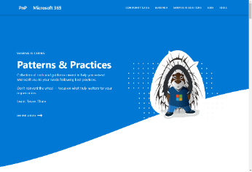
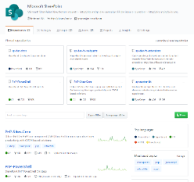
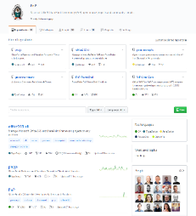
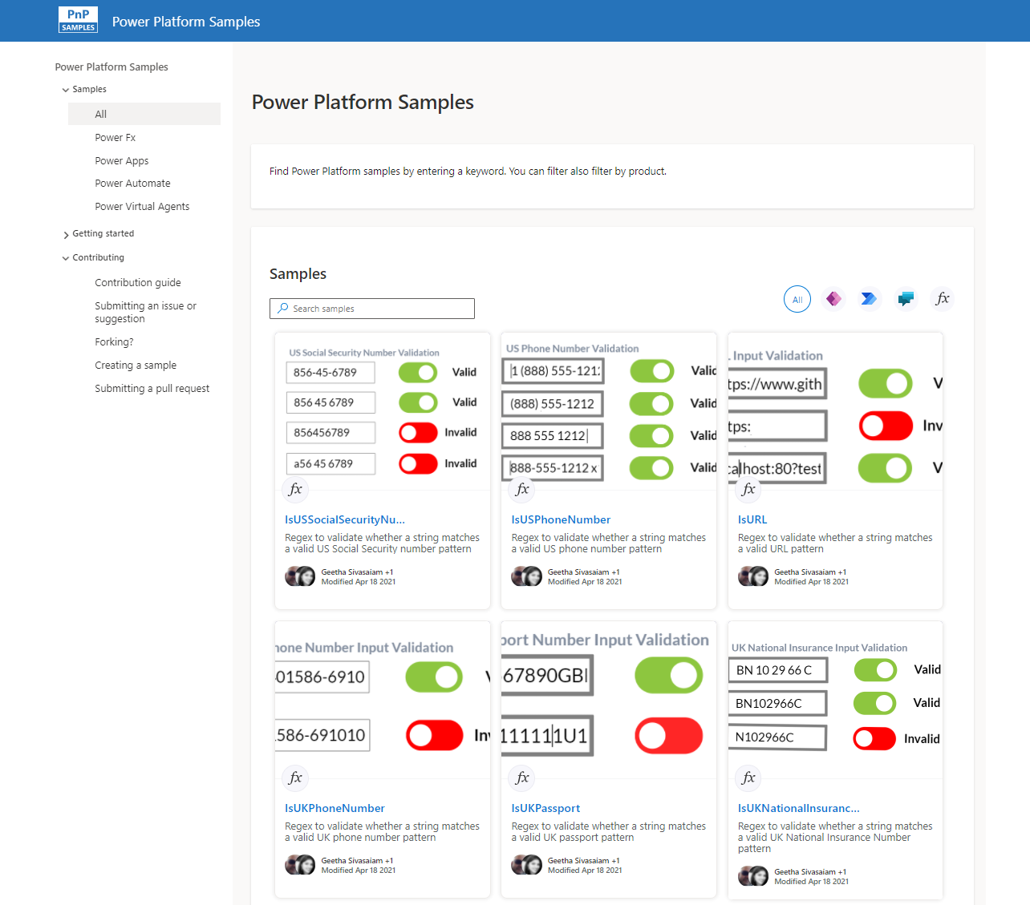
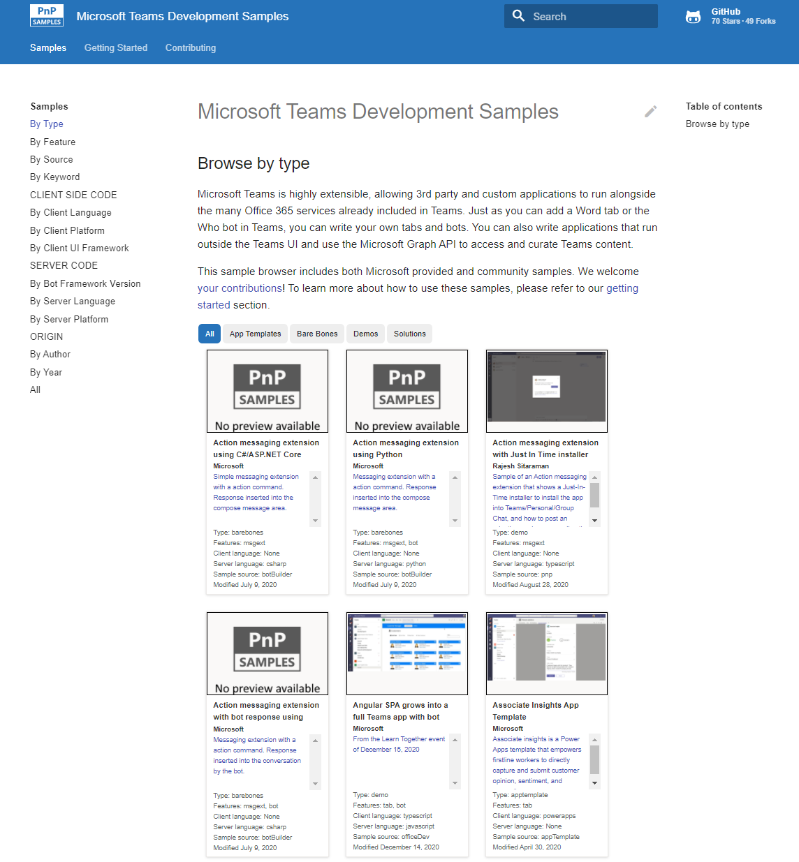
Microsoft 365 developer videos
Microsoft 365 community videos
Open-source
Sample galleries
Open-source initiatives and samples
github.com/sharepoint
github.com/pnp
github.com/officedev
github.com/microsoftgraph
aka.ms/m365/samples
aka.ms/teams-samples
aka.ms/spfx-webparts
aka.ms/powerplatform-samples
aka.ms/spfx-extensions
aka.ms/list-formatting
aka.ms/m365/community
aka.ms/m365devyoutube
aka.ms/m365pnp/videos
@Microsoft365Dev | @m365pnp

Slide 5
Microsoft 365 developer community calls
Microsoft 365 platform (weekly) https://aka.ms/m365-dev-call
(Notice. This call is on a summer break between July 1st and 31st of August 2022 – next call on 6th of September)
Adaptive Cards https://aka.ms/adaptivecardscommunitycall
Microsoft identity platform https://aka.ms/IDDevCommunityCalendar
Office Add-ins https://aka.ms/officeaddinscommunitycall
Power Platform https://aka.ms/PowerPlatformMonthlyCall
Microsoft 365 & Power Platform Development (bi-weekly) https://aka.ms/m365-dev-sig
Viva Connections & SharePoint Framework (bi-weekly) https://aka.ms/spdev-spfx-call
Download recurrent invites from
https://aka.ms/m365/calls
Notes:
m365-dev-sig

Slide 6







Latest news from Microsoft engineering on Microsoft 365 topics
Community together mode group photo
Brian Jackett & Cameron Parker - Latest on eDiscovery Premium APIs on Microsoft Graph
Alex Terentiev & Vesa Juvonen - SPFx feature demo/preview
Merill Fernando - Introduction to Graph X-Ray
AGENDA
Microsoft 365 platform call 6th of September @ 8 AM PT
Weekly call with Microsoft presenters covering the latest Microsoft 365 platform updates
Download recurrent invite from https://aka.ms/m365-dev-call
Notes:
Dan’s slide

Slide 7
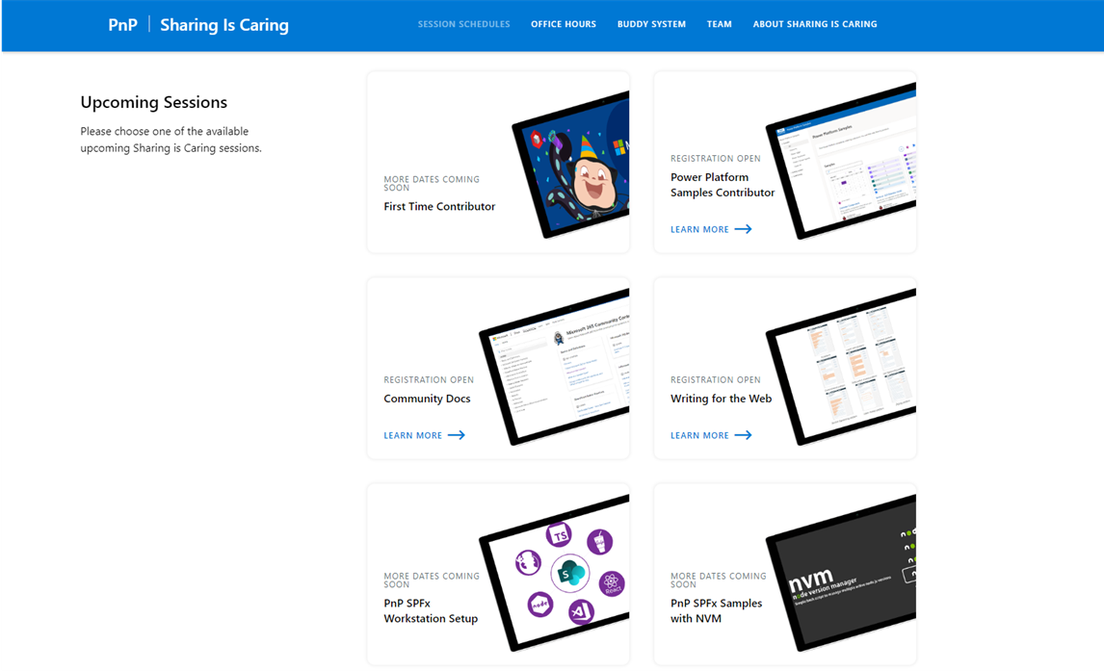
GUIDANCE
Learn how to get started in the open-source PnP community!
Upcoming Sessions:
First-time contributor
Power Platform Samples Contributor
Writing for the Web
Community Content Docs
SPFx Developer Workstation Setup
Using PnP SPFx samples w/ NVM
More than code with VS Code
First-time presenter
M365 Maturity Model Practitioners
Power Platform Samples Contributor
Live at Power Platform Conference
https://aka.ms/sharing-is-caring
Notes:
25 Total attendees, 16 attendees who attended both First-Time Contributors and Community Docs sessions.

Slide 8





COMMUNITY
PnP Recognition Program
Showcasing your contributions
Powered by Credly
More achievement levels coming soon
https://aka.ms/m365pnp-recognition
Notes:
25 Total attendees, 16 attendees who attended both First-Time Contributors and Community Docs sessions.

Slide 9
PnP .NET libraries A set of libraries that helps Microsoft 365 .NET developers to be more productive when working with SharePoint and Teams

Slide 10
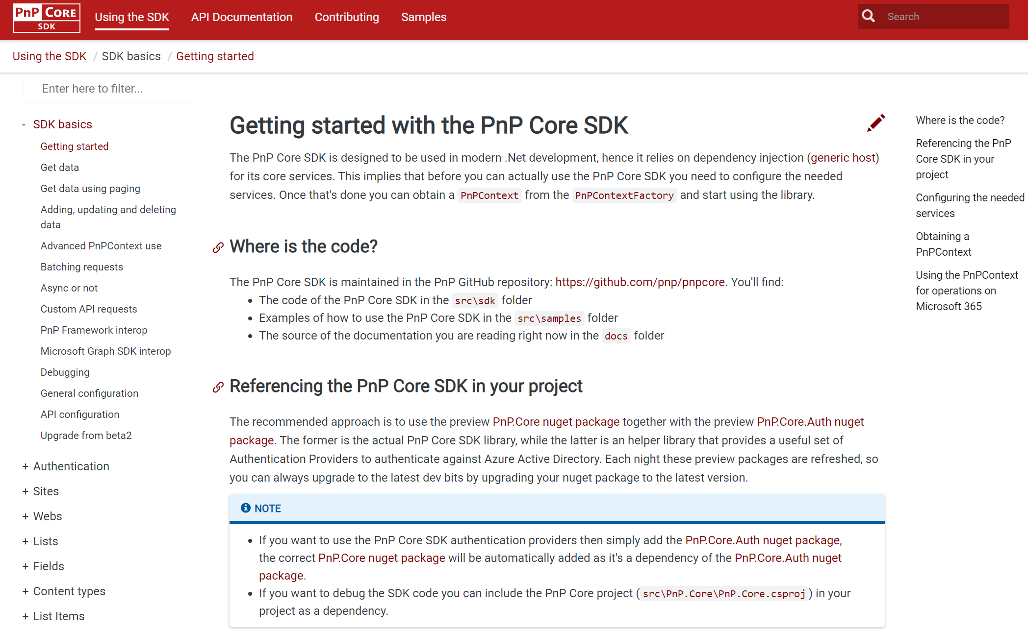
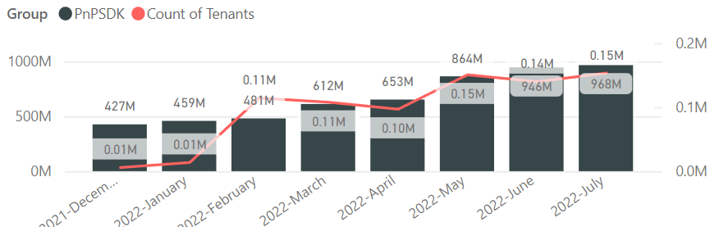
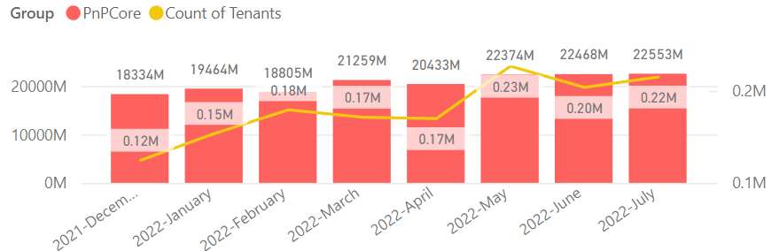

PnP .NET libraries
PnP Framework
PnP Core SDK
>220.000
Tenants in a month!
>711,000 downloads!
Prepping 1.11.0 (after summer break):
Merge pending PRs
General fixes and improvements: 👍 Ronald Booden, Daniel Pastoor, Ole Rühaak and friendbool
New PnP Provisioning Schema v. 202209 is upcoming
Feedback welcome on GitHub repo (https://github.com/pnp/PnP-Provisioning-Schema)
>930,000 downloads!
Prepping for 1.8.0 (after summer break):
Integrate license information in Nuget packages: Landon Petzoldt 👍💪🚀
Support for column defaults, re-indexing of a list or web and test mocking (via Moq): Bert Jansen 🚀
Fixes and improvements: Martin Lingstuyl, Llewellyn Roos, Bert Jansen 👍
Working on it
What key scenarios are still missing?
https://github.com/pnp/pnpcore/blob/dev/src/sdk/CHANGELOG.md
Roadmap
nuget.org/profiles/pnp
nuget.org/profiles/pnp
aka.ms/pnp/framework
aka.ms/pnp/coresdk

Slide 11
PnP PowerShell Open-source cmdlets which provide you an easy way to manage your SharePoint and Teams environment.

Slide 12
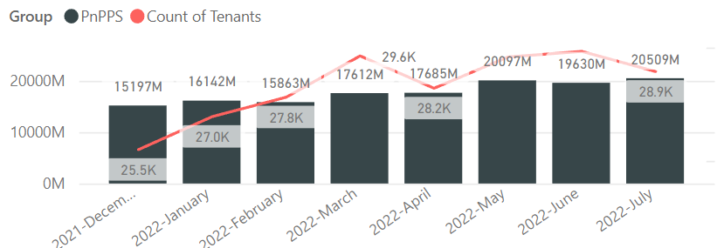

PnP PowerShell
Cross Platform PnP PowerShell
~29.000 monthly tenants!
V1.11.0 released Many updates, improvements and fixes!
2.9 million downloads!
100 million cmdlets executed per day!!
Docs shifted, no more docs.microsoft.com
Documentation, Articles and tips available at https://pnp.github.io/powershell
Thinking of dropping support for PS 5, any strong objections ???
PnP PS runs in PS 5, PS 7, Azure CloudShell, Azure Functions, Azure Runbooks & Raspberry Pi
New Stuff
1.11.0 released, nightly builds continue, go check it out
Improved exception handling and verbose messaging
Improved Microsoft 365Group related cmdlets
Added DisplayNamesOfFileViewers and DisplayNamesOfFileViewersInSpo params to Tenant cmdlets
What next ? Would love to hear your thoughts !
Release: https://github.com/pnp/powershell/releases/tag/v1.11.0
Working on it
github.com/pnp/powershell
www.powershellgallery.com
PnP.PowerShell
https://github.com/pnp/powershell/blob/dev/CHANGELOG.md

Slide 13
yo teams Open-source Yeoman generator for Microsoft Teams development

Slide 14
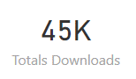
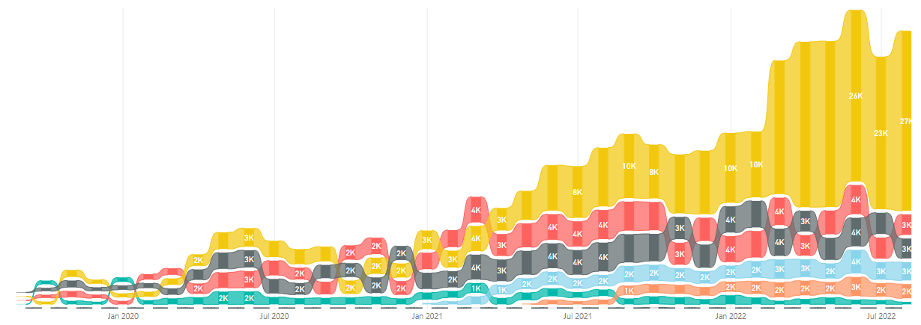
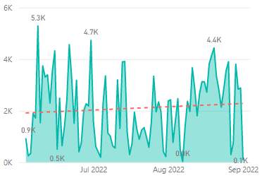
yo teams
Help wanted 🤝
https://aka.ms/yoteams
generator-teams – The Teams apps generator
Package Downloads
📃 Docs published at https://pnp.github.io/generator-teams/
🚀 Latest release: 4.0.1 [2022-06-28]
Fixed an issue with tab configuration
📅 Top of mind:
Option to add SSO for teams apps during scaffolding
Option to integrate Microsoft Graph Toolkit
Update UX of scaffolded tabs
Add support for meeting extensions
More Docs & Tutorials
yoteams-build-core
yoteams-deploy
Daily build events
🚀 Latest release: 1.7.0 [2022-06-23]
Added support for Schema 1.13. Requires Node 14 or later Dependency package updates Fixed issue with telemetry timeout at the end of scaffolding
🔮 Preview: n/a 📅 Roadmap: ???
🚀 Latest release: 1.2.0 [2022-06-23]
Requires Node 14 or later Dependency package updates
🔮 Preview: : n/a
📅 Roadmap:
???

Slide 15
Microsoft Graph Toolkit Web Components powered by Microsoft Graph

Slide 16

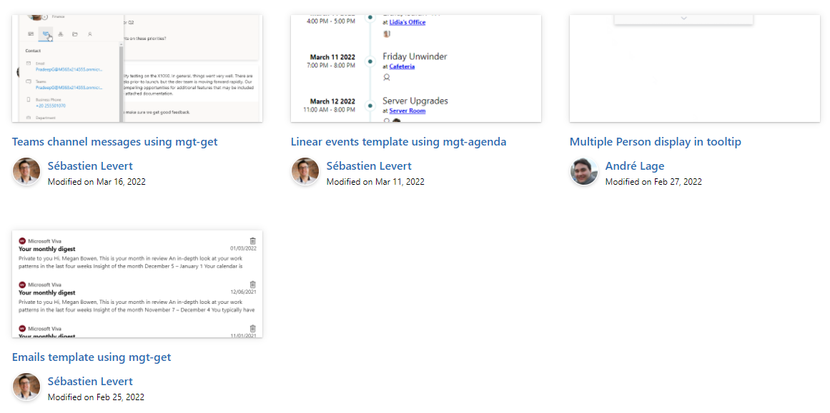

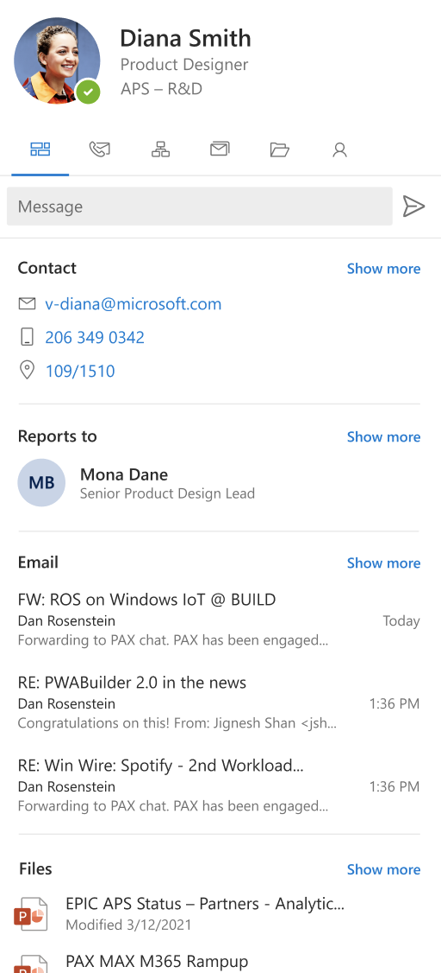
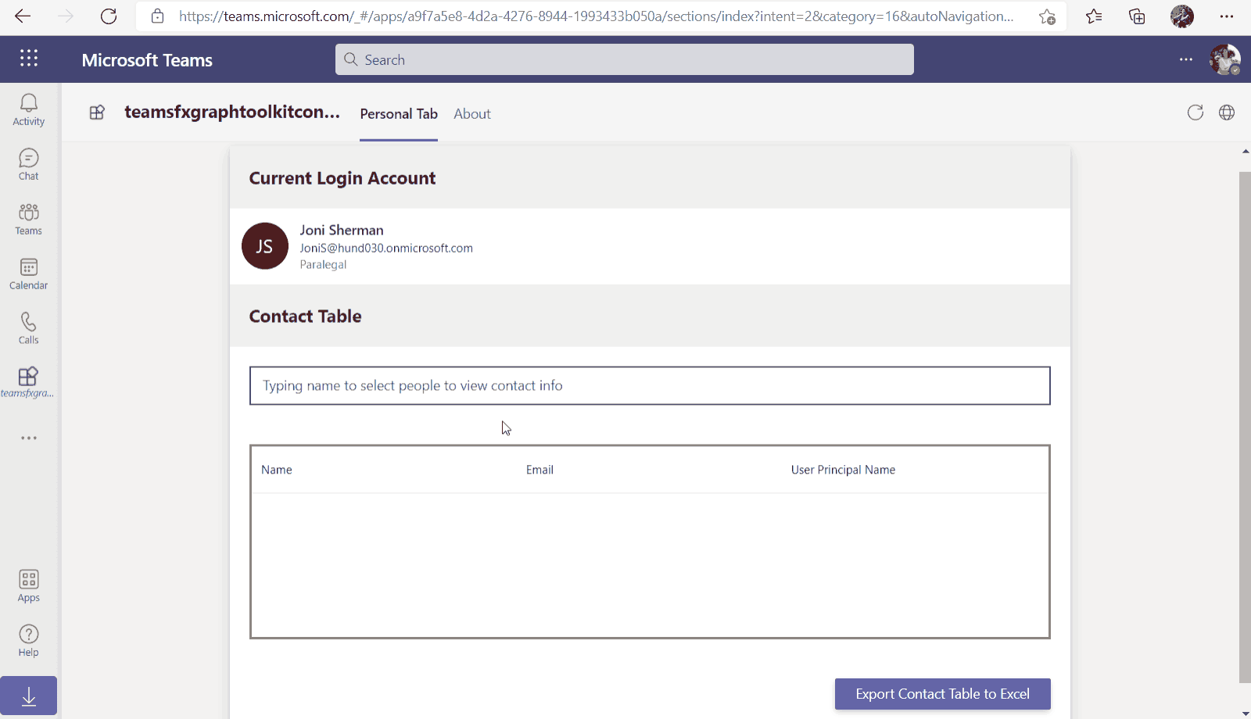
Microsoft Graph Toolkit
👀 More information: aka.ms/mgt
What’s new 🎉
V2.6.0 is our latest release! Update your packages! https://aka.ms/mgt/v2.6.0
Accessibility updates
Support for SPFx 1.15
Documentation on TeamsFx
Updates mgt-people-picker
Thanks @wuxiaojun514 for your contributions 🎉
The MGT samples repository is live! Keep your contributions coming! https://aka.ms/mgt/samples
What's next? 💻
Aligning all Toolkit components to Fluent UI Web Components
More generic components and theming capabilities
We need your help ❤️
🐞 Help us fix bugs
🆕 Help us build/improve features
help-wanted & good-first-issue -> https://aka.ms/mgt/issues

Slide 17

Independent Publisher Connectors
What’s new
53 Awesome Independent Publishers!
168 Independent Publisher connectors!
New connectors:
Joe Unwin- Fantasy Premier League
Richard Wilson (Welcome!)- Mockaroo
Simone Lin (Welcome!) - Mapbox
Troy Taylor- Near Earth Object Web Service
Troy Taylor- USGS Earthquake Hazards
We need your help
Become an Independent Publisher by building one of these connectors: Top Connector Asks · microsoft/PowerPlatformConnectors Wiki (github.com)
OR
By adding more functionality to one of the existing Independent Publisher connectors on the Power Platform

Slide 18
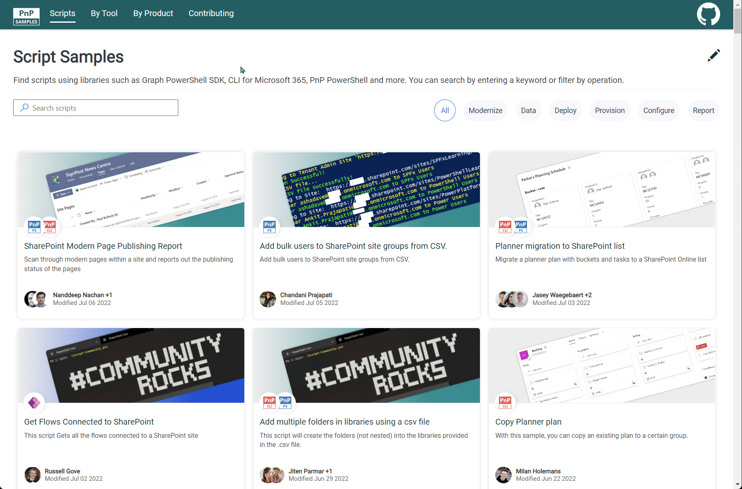
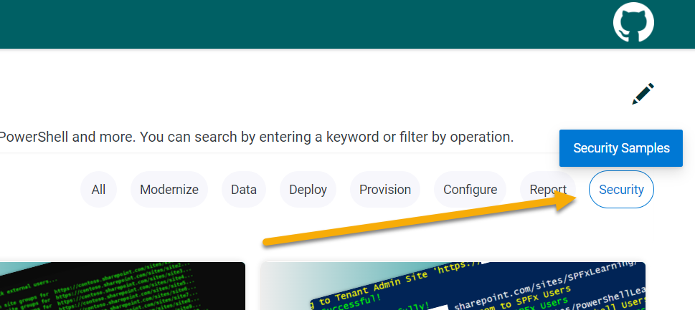


SCRIPT SAMPLES
One centralized location for all scripts for helping your day-to-day life. Contribution's welcome!
Site now has 165 scenarios and 250 scripts, using Microsoft Graph, CLI for Microsoft 365, PnP PowerShell, SPO Management Shell tooling and more…😁 AND samples integrated into "Unified" Solution Gallery
Awesome 🤩😃🎉👏 Samples Include :
New scenarios using CLI for Microsoft 365 Scripts
Get notified in Microsoft Teams about SharePoint health incidents by Martin Lingstuyl
Updated Scenarios with CLI for Microsoft 365 Scripts
Ensure the Site Assets Library is created by Martin Lingstuyl
Site Feature: Now filter scripts used for security and permissions
Thank you for your samples and contributions – your awesome and happy summer holidays!
Ramin Ahmadi
Martin Lingstuyl
Reshmee Auckloo
Todd Klindt
Leon Armston
Paul Matthews
Lewis Baybutt
Ramin Ahmadi
Arash Aghajani
Michaël Maillot
👏
aka.ms/script-samples
good first issue
We have good firsin the GitHub Repo with sample ideas of scripts that you could contribute to ☺ https://github.com/pnp/script-samples

Slide 19



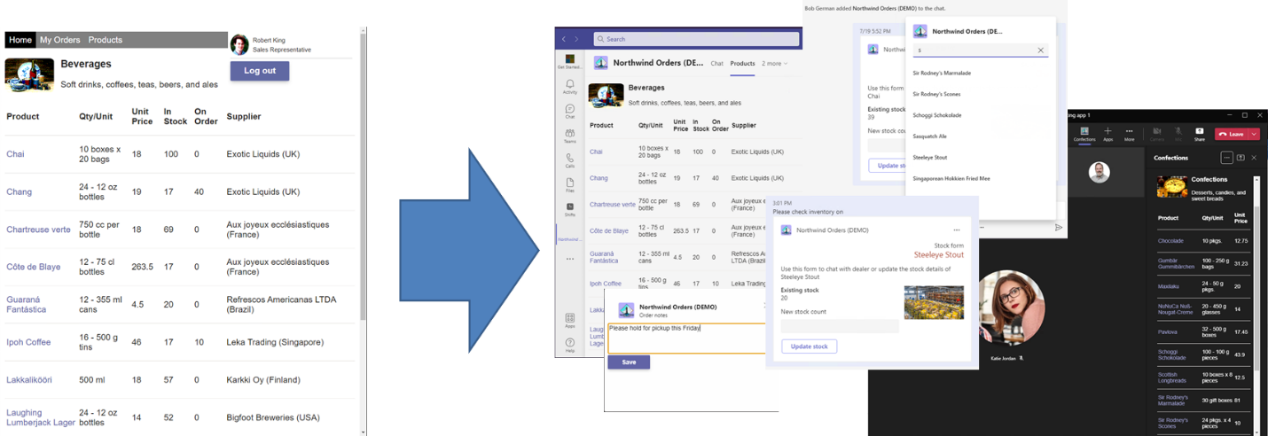





Microsoft Teams Samples
Please check out all the samples! https://aka.ms/m365-samples
https://aka.ms/teams-samples
Microsoft Teams App camp
Volunteers Needed!
SAMPLES WANTED!
Hands-on labs and samples:
Port a web site to a Teams app w/Azure AD SSO
Implement identity linking from a non-Azure AD identity system to Azure AD
Messaging extension with adaptive card
Configurable tabs, meeting app, dialogs, deep links
Monetize the app in the Teams app store
https://aka.ms/app-camp
Check out all the samples! https://aka.ms/m365-samples
Teams samples w/filtering https://aka.ms/teams-samples
Notes:
Wajeed Shaikh – Teams PM

Slide 20

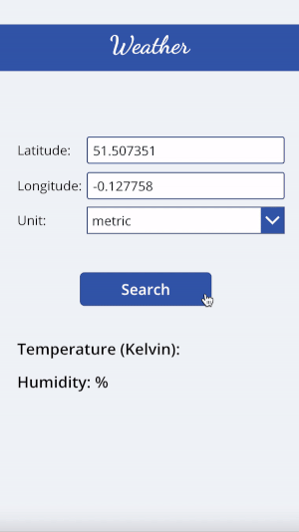
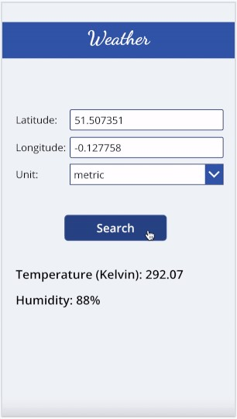



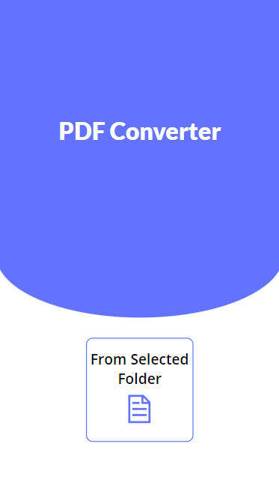
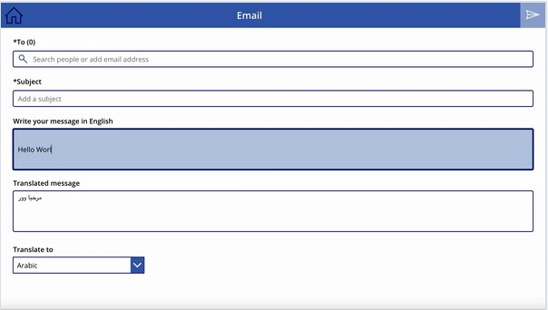

Power Platform Samples
New:
Email Translation Lama Alluwaymi | Lama-alluwaymi
PDF Converter Lama Alluwaymi | Lama-alluwaymi
Weather Sample Lama Alluwaymi | Lama-alluwaymi
aka.ms/powerplatform-samples ​
Notes:
These are the updates that we processed since out last call.
New samples:
- Power Automate: SharePoint Collect Feedback April Dunnam | @aprildunnam Demonstrates:
Executing a Flow from a SharePoint Library with input parameters
Leveraging the custom responses option in Power Automate approvals
https://github.com/pnp/powerautomate-samples/tree/main/samples/sharepoint-collect-feedback
- Power Automate: Get Graph API Data within Power BI Reports Scott McKenzie | @365EDUBI Enables Graph API data to be refreshed within the Power BI Service. https://github.com/pnp/powerautomate-samples/tree/main/samples/graph_api_in_power_bi
Updated samples:
Power App: Fluent UI Custom Theme Fabio Franzini | @franzinifabio Fixed datepicker control theme https://github.com/pnp/powerapps-samples/tree/main/samples/fluentui-custom-theme
These latest samples should show within 24 hours

Slide 21


Optional picture time!
Video on and we’ll grab a Together Mode pic with those who are willing to do this.
We are together on this as a community!
By enabling your camera for the picture, you’ll give us the permission to share your picture in social media.

Slide 22
DEMO
Independent Publisher Connector - OpenAI Demo – Robin Rosengrün
How to animate SVGs in Adaptive Cards – Kristine Kolodziejski

Slide 23

Q&A

Slide 24
Thank you
Recording will be available in 24 hours on
Microsoft 365 Community (PnP) YouTube channel
https://aka.ms/m365/videos
(subscribe today)
Follow us on Twitter
@Microsoft365Dev | @M365PnP
Next M365 General Dev call: September 15th at 07:00am PT
Next Viva Connections & SharePoint Framework call: September 8th at 07:00am PT
See all other community calls from https://aka.ms/m365/calls

Slide 25



Slide 26
Thank you

